Slide 1
Patsy
for Statistical Modeling
Mark Mummert - DC DSI4
April 4, 2017

Slide 2
Review Objectives
Interaction Terms
Patsy Syntax
Uses
Generate Matrices
Linear Modeling
Logistic Regression
Implementation in python

Slide 3
Interaction Terms

Slide 4
Review of Interaction Terms
Why do we use interaction terms?
Account for interaction of dependent variables in multivariate linear regressions
Account for relationships in logistic modeling

Slide 5
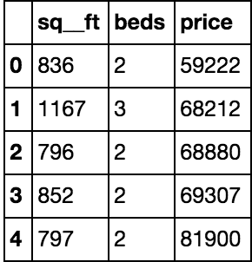
Accounting for Interaction Terms
Notes:
Example - building a model to fit an interaction term - this is what you’d do
Account for relationship - 2 or 3 interaction terms

Slide 6
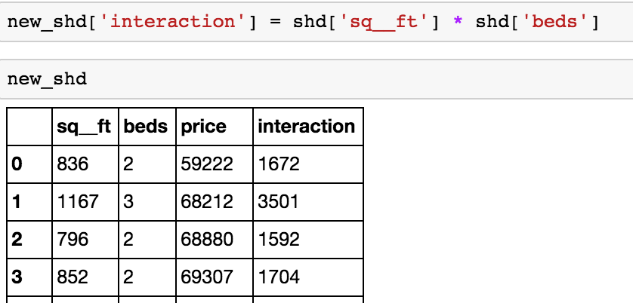
Accounting for Interaction Terms

Slide 7
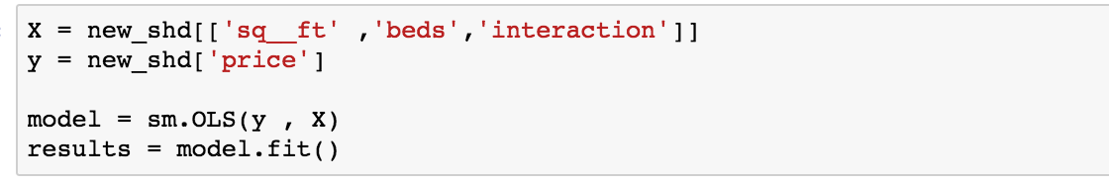
Accounting for Interaction Terms

Slide 8
With Patsy

Slide 10
price ~ sq__ft + beds + sq__ft : beds
Notes:
You can fit the model with this _____

Slide 11
What is Patsy?
Python library used to specify model formulas within statsmodels
Can more easily account for higher order and interaction terms in statsmodels

Slide 12
price ~ sq__ft + beds + sq__ft : beds
Y Value
B Variable
A Variable
Interaction Term
Notes:
You can fit the model with this _____

Slide 13
Explaining Patsy Terms
~
Divides left and right side of the equation
+
Completes a union of the two variables
-
Finds the difference between two variables

Slide 14
Explaining Interaction Terms
:
Describes the interaction between variables
*
Includes original terms and interaction
A + B + A : B
= A * B

Slide 15
Not Just For Interactions
Can be used to create any linear model formula

Slide 16
In Code

Slide 17
In Code
Generate Matrices
Turn Matrices to Models

Slide 18
Generating Matrices
y , X = patsy.dmatrices("price ~ sq__ft + beds + sq__ft : beds", data=shd)
y
X
[ 59222 ]
[ 68212 ]
[ 6880 ]
[ 1
[ 1
[ 1
836
1167
796
2
3
2
1672 ]
3501 ]
1592 ]
Notes:
These can be plugged into a formula

Slide 19
Generating a Linear Model:
model =
smf.ols(formula=
"price ~ sq__ft + beds + sq__ft * beds",
data = shd
).fit()

Slide 20
Patsy for Logistic Regression
model = sm.logit( "high_quality ~ residual_sugar +
alcohol + residual_sugar : alcohol", data = df ).fit()

Slide 21
Documentation
http://patsy.readthedocs.io/en/latest/index.html

Slide 22
Questions

